Slide 1
ADJUSTABLE DC POWER SUPPLY
Converting AC to DC Supply !

Slide 2
MEET OUR TEAM !
157
162
166
173
DARSH TRIVEDI
22002170110195
AGRESHA SHAH
22002170110155
YASVI VAGHASIYA
22002170110199
22002170110107
CHIRAG PATEL
178
22002170110166
KEVAL SHAH
22002170110178
182
SHLOK PATEL

Slide 3
PROJECT PURPOSE !
IN OUR DAY TO DAY LIFE WE USE DIRECT SUPPLY OF VOLTAGE AND CURRENT FROM PLUGS IN OUR HOME AND OFFICE.
BUT SUPPLY FROM SUBSTATION COMES NEAR TO APPROX 240 V AND VOLTAGES ALTERNATING.
SO TO CONVERT THAT LARGE ALTERNATING SUPPLY OF VOLTAGE INTO STABLE DIRECT SUPPLY WE HAVE MADE THIS REGULATED DC SUPPLY.
WE CAN USE THIS IN CHARGING LAPTOP , MOBILE , OPERATING FRIDGE AND WASHING MACHINES AND MANY MORE.

Slide 4
COMPONENTS USED !
AIM: TO CONVERT ALTERNATING SUPPLY TO DIRECT AND CONSTANT SUPPLY
12-0-12 5-AMP TRANSFORMER | USED AS STEP DOWN DEVICE TO STEP DOWN THE 240 V AC SUPPLY INTO 12 V AC SUPPLY
7812 VOLTAGE REGULATOR | TO PROVIDE STABLE +12V POWER SUPPLY
4 PIN MODULE BRIDGE RECTIFIER | CONVERTS AN AC CURRENT INTO A DC BY USING ONE OR MORE P-N JUNCTION DIODES
4700 MICRO FARADAY CAPICATOR | SMOOTH CURRENT FLUCTUATIONS FOR SIGNAL OR CONTROL CIRCUIT
2 PIN TERMINAL BLOCKS | TO MEASURE OUTPUT AND INPUT VOLTAGE BY MULTIMETER
PCB | IT PROVIDE ELECTRICAL CONNECTION AND MECHANICAL SUPPORT TO CIRCUIT

Slide 5
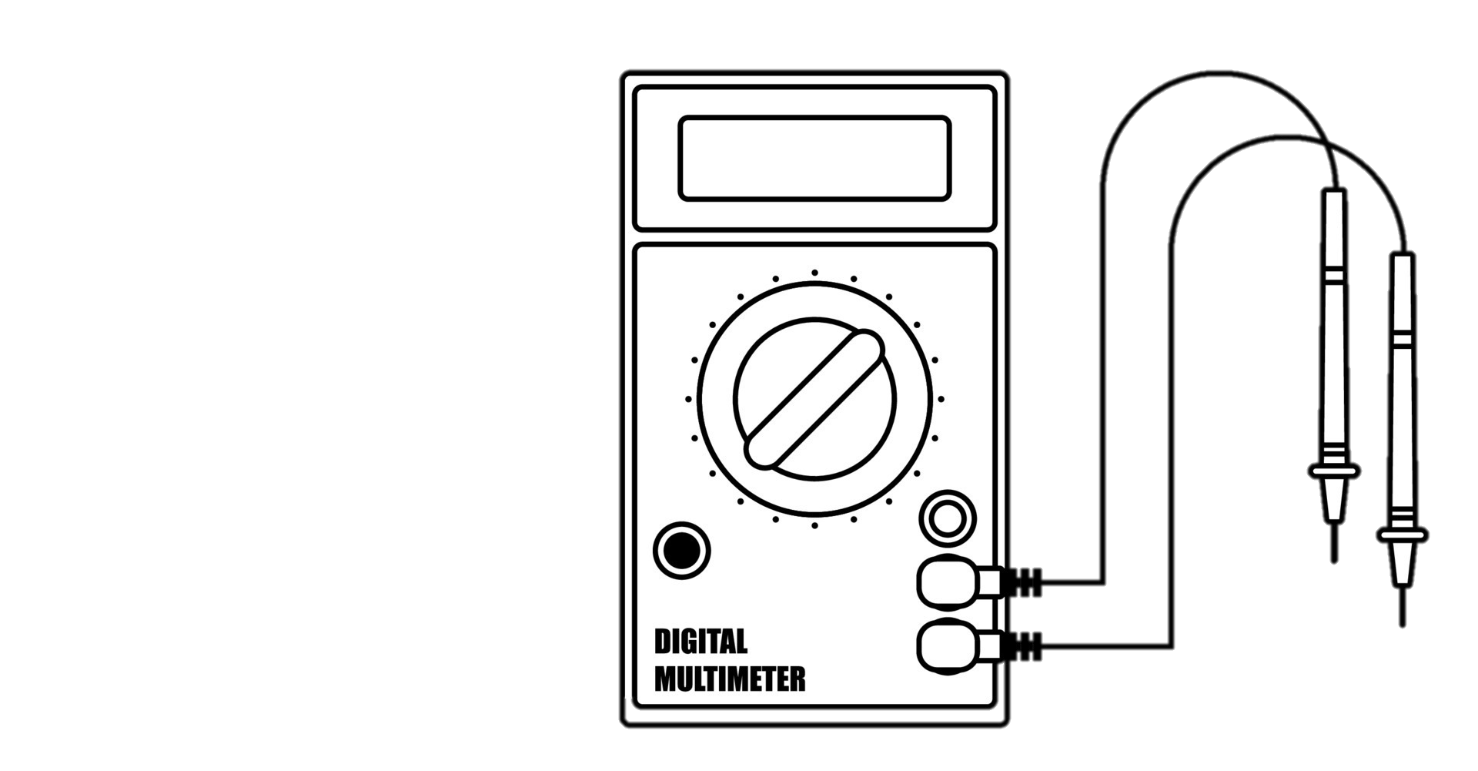
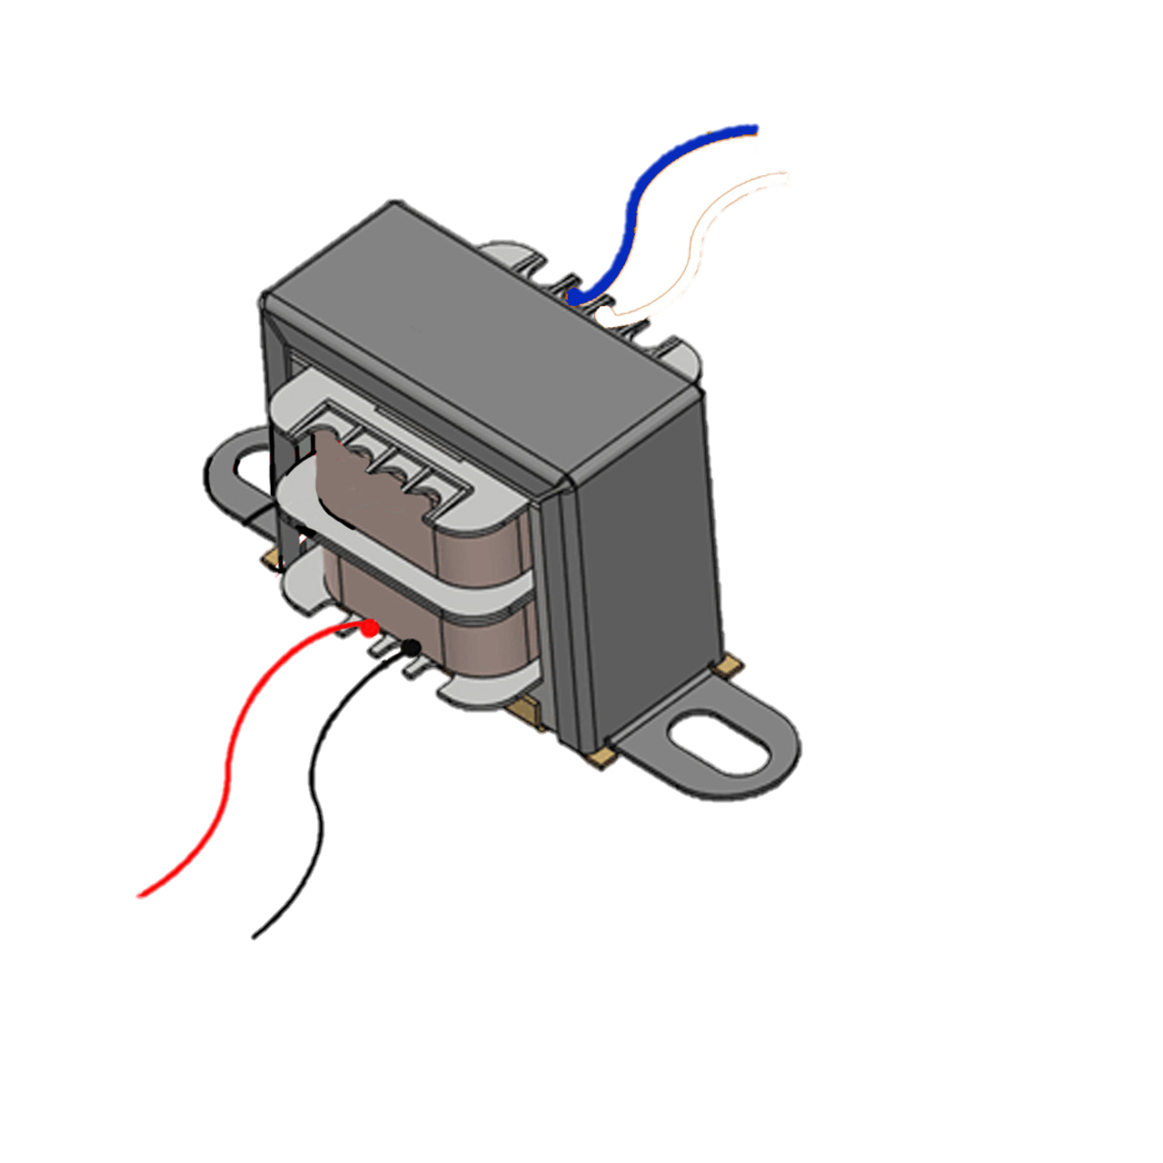
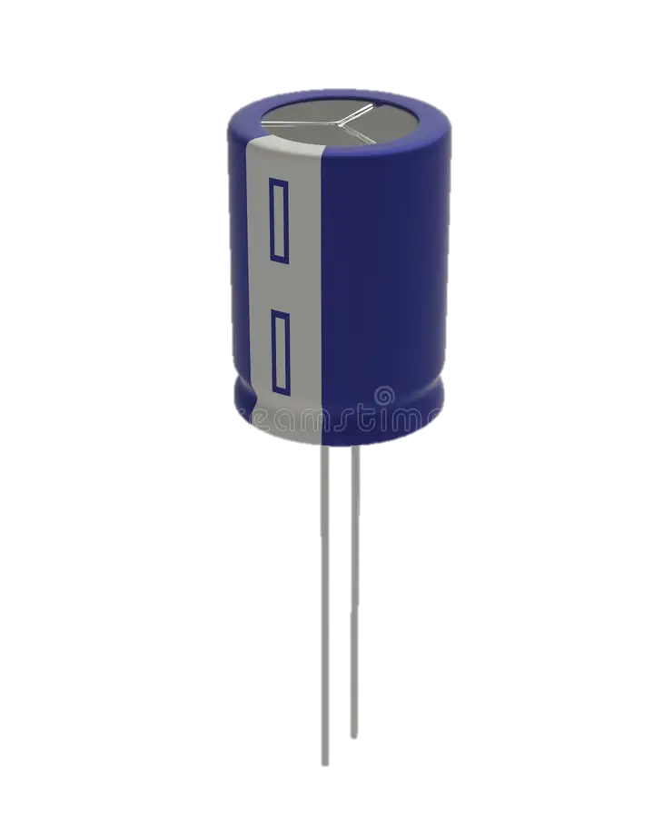
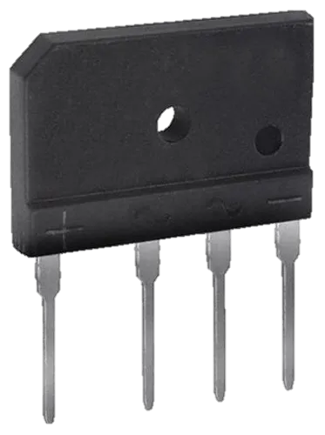
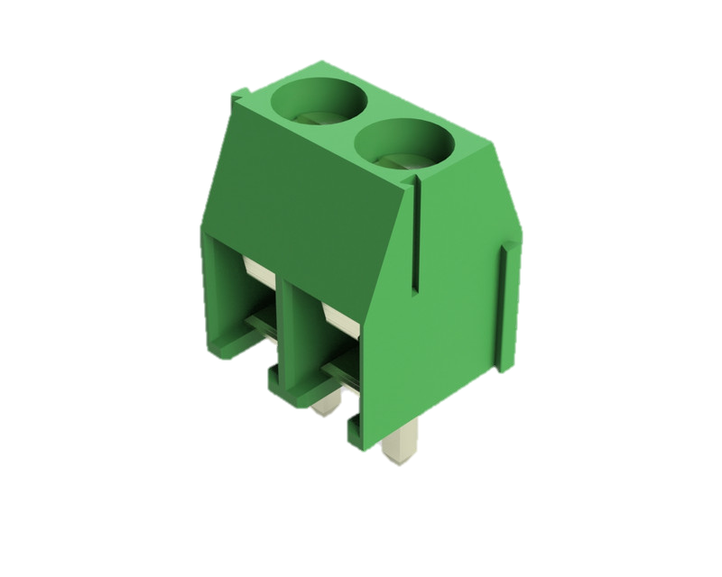
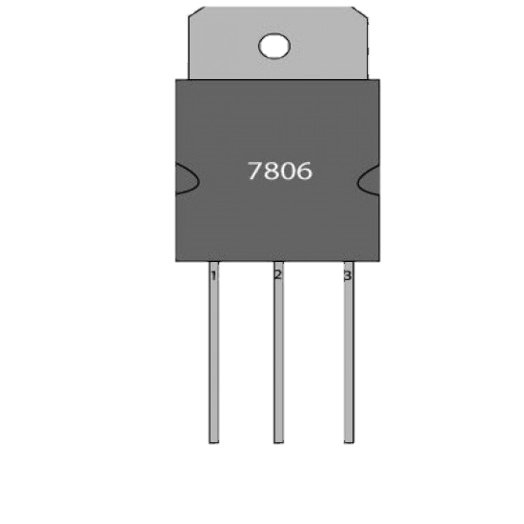
CIRCUIT DIAGRAM
AC MAINS SUPPLY
7812
RECTIFICATION
TRANSFORMER
REGULATING VOLTAGE
SMOOTHING

Slide 6
MERITS & DEMERITS
MERITS
Voltage stability
Current limiting
Reduced electromagnetic interference (EMI)
Reliable performance
DEMERITS
Cost
Complexity
Size and weight
Heat generation
Limited voltage range

Slide 7
APLLICATIONS
Electronics testing and prototyping
Battery charging and testing
Industrial automation
LED lighting
Electric vehicle charging

Slide 8
THANK YOU !

